Slide 1
MIS 321
Factory Design Pattern

Slide 2
Creational Patterns
Creational patterns involve object instantiation and provide a way to decouple a client from the objects it needs to instantiate.
Yes……. More decoupling……

Slide 3
Factory Design Pattern
Intent: to define an interface for creating an object, but let subclasses decide which class to instantiate.
Factory method lets a class defer instantiation to subclasses.
Use the Factory Pattern when:
A class can’t anticipate the class of objects it must create
A class wants its subclasses to specify the objects it creates

Slide 4
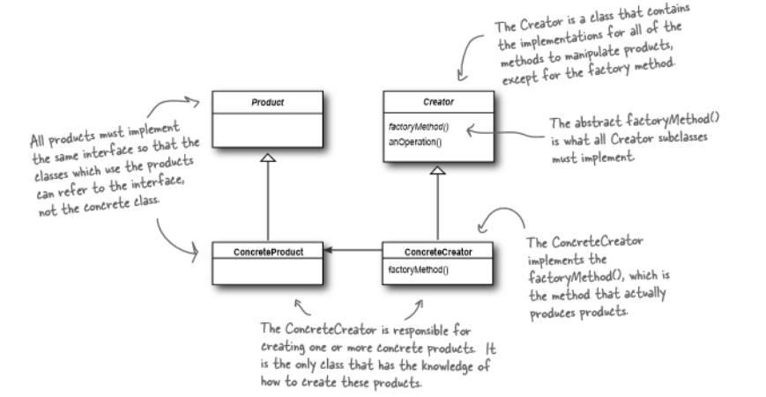
Factory Design Pattern
© Headfirst Design Patterns Pg. 134

Slide 5
Simplified Design Principle
Depend upon abstractions. Do not depend upon concrete classes.
Dependency Inversion Principle
Similar to “code to an interface”, but makes an even stronger statement about abstraction
Suggests that our high-level components should not depend on low-level components; rather, they should BOTH depend on abstractions.

Slide 6
The Problem – Let’s keep talking pizza
Our local pizza store would like to franchise.
They know that what is thought of as “pizza” in Chicago, is very different than New York, which is very different from Southern California.
How can we abstract these differences from our Pizza Store class that will be used in every franchised location?

Slide 7
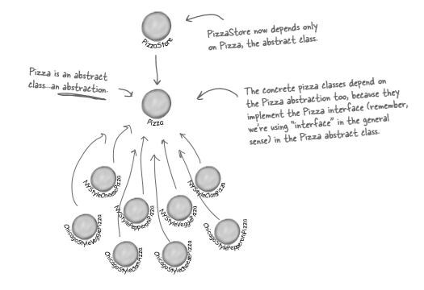
The Problem – How would you solve this today?
After applying the Factory Method, the PizzaStore (our high level component) and the individual pizzas (our low level components) all depend on the abstraction of the abstract pizza class.
© Headfirst Design Principles pg. 140

Slide 8
Advantages
Allows sub-classes to choose the type of objects to create
Promotes loosely coupled code by eliminating the need to bind application-specific classes into the code.

Slide 9
Disadvantages
Whenever the class selection criteria change, every application object that uses the class hierarchy must undergo a change.
Because class selection criteria needs to take all the factors that could affect the selection process into account, the implementation of an application object could contain complex conditional statements.

